Slide 1
Graph Theory

Slide 2
What are Graphs?
Generally we understand graph as a plot or chart of numerical data
The technical meaning of graphs in DS, A particular type of discrete structures useful for representing the relations
Problems in almost every conceivable discipline can be solved using graph models.
Graphs can represent/model potentially any type of relation in a very convenient way and relations describe most of the real life system
Graphs are used to represent who influences whom in an organization, represent the outcomes of round robin tournaments, networking/linking of phones, webs, trains, planes, buses, roads, circuits etc., scheduling and path planning problems, computer game playing, etc.

Slide 3
Definition of Graph
A graph G = (V, E) consists of V, a nonempty set of vertices or nodes, and E, a set of edges. Each edge has either one or two vertices associated with it, called its endpoints.
An edge connects its endpoints.
The number of vertices V of a graph G may be infinite. A graph with infinite vertices is called an infinite graph.
A graph with a finite vertex set and a finite edge set is called a finite graph. We will study only finite graphs.

Slide 4
Example..
Suppose that a network is made up of data centers and communication links between computers.
We can represent the location of each data centre by a point or vertex and link by a line segment or edge as shown in next slide.

Slide 5
Detroit
New York
San Francisco
Chicago
Denver
Washington
Los Angeles

Slide 6
Multigraph: A multigraph G = (V, E) consists of a set V of vertices, a set E of edges, and a function f from E to {{u, v} | u, v ∈ V, u ≠ v}.
The edges e₁ and e₂ are called multiple or parallel edges if f(e₁) = f(e₂).
Note:
Edges in multigraphs are not necessarily defined as pairs, but can be of any type.
No loops are allowed in multigraphs (u ≠ v).

Slide 7
Example: A multigraph G with vertices V = {a, b, c, d}, edges {1, 2, 3, 4, 5} and function f with f(1) = {a, b}, f(2) = {a, b}, f(3) = {b, c}, f(4) = {c, d} and f(5) = {c, d}:
1
4
a
b
3
c
d
2
5

Slide 8
Pseudo graph:
If we want to define loops, we need the following type of graph:
A pseudo graph G = (V, E) consists of a set V of vertices, a set E of edges, and a function f from E to {{u, v} | u, v ∈ V}.
An edge e is a loop if f(e) = {u, u} for some u∈V.

Slide 9
Pseudograph
If we remove self loops, then it represents
a multigraph.
Detroit
New York
San Francisco
Chicago
Denver
Washington
Los Angeles

Slide 10
Directed Graphs
Till now we have seen graphs in which edges do not have direction or edges are undirected. These graphs are called undirected graphs.
However, in some graph models, it may be essential to assign directions to the edges of a graph.
So, we define directed graphs

Slide 11
Directed Graph: A directed graph G = (V, E) consists of a set V of vertices and a set E of edges that are ordered pairs of elements in V.
Directed MultiGraph: A directed multigraph G = (V, E) consists of a set V of vertices, a set E of edges, and a function f from E to {(u, v) | u, v ∈ V}.
The edges e₁ and e₂ are called multiple edges if f(e₁) = f(e₂).
When there are m directed edges, each associated to an ordered pair of vertices (u, v), we say that (u, v) is an edge of multiplicity m.

Slide 12
A Directed Graph
A Communications Network with One-Way Communications Links
Detroit
New York
Chicago
San Francisco
Denver
Washington
Los Angeles

Slide 13
A Directed Multigraph
A Computer Network with Multiple One-Way Links.
Detroit
New York
Chicago
San Francisco
Denver
Washington
Los Angeles

Slide 14
Types of Graphs and Their Properties
Type
Edges
Multiple Edges?
Loops?
simple graph
undirected
no
no
multigraph
undirected
yes
no
pseudograph
undirected
yes
yes
directed graph
directed
no
yes
dir. multigraph
directed
yes
yes

Slide 15
Graph models
Graphs have applications to a wide variety of disciplines and due to that sometimes terminologies might vary.
But there are three key questions regarding graphs which help us understand the structure of graph.
Are the edges of the graph directed or undirected (or both)?
Are multiple directed or undirected edges present that connect the same pair of vertices?
Are loops present?

Slide 16
Some applications:
Graphs are used to model variety of problems.
We will take up some applications to examine how to construct graph models
We have already seen the model for communication networks linking data centers.
Now we will take interesting problems.
While building the models, we need to make sure that we answer the three questions posed in previous slide about the structure of the graph.

Slide 17
Communication networks
Social networks: Graphs are used to model social structures based on different kinds of relationships between people or groups of people and these are called social networks. These can be of many …types.
Let us see some of them:
Acquaintanceship and friendship graph:
Graph type: Simple graph (no loops, no multiple edges)
Node: a person
Edge: If both are Friend/know

Slide 18
Cont..
b. Influence Graph: A person influences the thinking of another person.
Directed graph, no loops, no multiple edges
c. Collaboration graph: Simple graph, no loops, no multiple edges
d. Call graph: models the telephone calls made in the network. A directed multigraph, where vertex is represented by a phone number

Slide 19
Information Networks
Graphs are used to model different types of networks linking particular type of information
The Web graph: Directed graph, node: web page
Edge starts from page a and end at page b if there is a link on a pointing to b.
Citation graph: Graphs are used to represent citations in different type of documents like: academic papers, patents and legal opinions.
It is a directed graph, without loops and multiple edges
Vertex represents a document and there is an edge from one document to another if first document cites another document.

Slide 20
Software Design applications
Module dependency graph:
It is a directed graph, without loops and multiple edges
Vertex represents a module and there is an edge from one module to another if second module depends on first
Precedence graph and Concurrent Processing
It is a directed graph with multiple edges
Vertex represents a statement and there is an edge from one statement to another statement if second statement can not be executed before first statement

Slide 21
Other Networks
Transport Networks
Airline Routes
Road Networks
Bus Routes
Biological Networks
Protein Interaction Graph
Ecological graphs
Tournament Networks:
Round Robin Tournaments, Single Elimination Tournaments

Slide 22
Degree based nomenclature of vertices
A vertex of degree 0 is called isolated, since it is not adjacent to any vertex.
Note: A vertex with a loop at it has at least degree 2 and, by definition, is not isolated, even if it is not adjacent to any other vertex.
A vertex of degree 1 is called pendant. It is adjacent to exactly one other vertex.

Slide 23
Graph Terminologies:
Definition: Two vertices u and v in an undirected graph G are called adjacent (or neighbors) in G if {u, v} is an edge in G.
If e = {u, v}, the edge e is called incident with the vertices u and v. The edge e is also said to connect u and v.
The vertices u and v are called endpoints of the edge {u, v}.

Slide 24
Definition: The degree of a vertex in an undirected graph is the number of edges incident with it, except that a loop at a vertex contributes twice to the degree of that vertex.
In other words, you can determine the degree of a vertex in a displayed graph by counting the lines that touch it.
The degree of the vertex v is denoted by deg(v).

Slide 25
Example: Which vertices in the following graph are isolated, which are pendant, and what is the maximum degree? What type of graph is it?
i
h
d
a
e
g
b
c
f
j
Solution: Vertex f is isolated.
Vertices a, d and j are pendant.
The maximum degree is deg(g) = 5.
This graph is a pseudograph (undirected, loops).

Slide 26
Example: Find the degree of all the other vertices.
deg( a ) = 2
deg( b ) = 6
deg( c ) = 4 deg( f ) = 3 deg( g ) = 4
TOTAL of degrees = 2 + 4 + 3 + 4 + 6 + 1 + 0 = 20
TOTAL NUMBER OF EDGES = 10
deg( d ) = 1
deg( e ) = 0
c
d
b
a
g
f
e

Slide 27
The Handshaking Theorem: Let G = (V, E) be an undirected graph with e edges. Then
2e = ∑_{v∈V} deg(v)
Note: This theorem holds even if multiple edges and/or loops are present.
Example: How many edges are there in a graph with 10 vertices, each of degree 6?
Solution: The sum of the degrees of the vertices is 6⋅10 = 60. According to the Handshaking Theorem, it follows that 2e = 60, so there are 30 edges.

Slide 28
Definition: In a graph with directed edges, the in-degree of a vertex v, denoted by deg⁻(v), is the number of edges with v as their terminal vertex.
The out-degree of v, denoted by deg⁺(v), is the number of edges with v as their initial vertex.
Question: How does adding a loop to a vertex change the in-degree and out-degree of that vertex?
Answer: It increases both the in-degree and the out-degree by one.

Slide 29
Theorem: An undirected graph has an even number of vertices of odd degree.
Idea: There are three possibilities for adding an edge to connect two vertices in the graph:
Before: After:
Both vertices have even degree
Both vertices have odd degree
Both vertices have odd degree
Both vertices have even degree
One vertex has odd degree, the other even
One vertex has even degree, the other odd

Slide 30
There are two possibilities for adding a loop to a vertex in the graph:
Before: After:
The vertex has even degree
The vertex has even degree
The vertex has odd degree
The vertex has odd degree

Slide 31







So if there is an even number of vertices of odd degree in the graph, it will still be even after adding an edge.
Therefore, since an undirected graph with no edges has an even number of vertices with odd degree (zero), the same must be true for any undirected graph.

Slide 32
Example: What are the in-degrees and out-degrees of the vertices a, b, c, d in this graph:
deg⁻(a) = 1
deg⁺(a) = 2
deg⁻(b) = 4
deg⁺(b) = 2
a
b
deg⁻(d) = 2
deg⁺(d) = 1
deg⁻(c) = 0
deg⁺(c) = 2
d
c

Slide 33
Theorem: Let G = (V, E) be a graph with directed edges. Then:
∑_{v∈V} deg⁻(v) = ∑_{v∈V} deg⁺(v) = |E|
This is easy to see, because every new edge increases both the sum of in-degrees and the sum of out-degrees by one.

Slide 34
Complete graph: The complete graph on n vertices, denoted by K_{n}, is the simple graph that contains exactly one edge between each pair of distinct vertices.
K₁
K₂
K₃
K₄
K₅

Slide 35
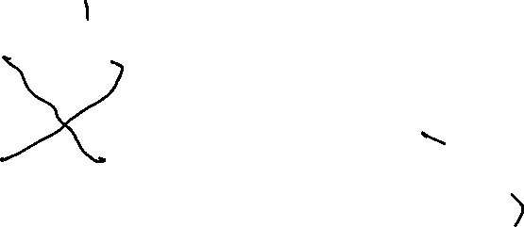
Cycle: The cycle C_{n}, n ≥ 3, consists of n vertices v₁, v₂, …, v_{n} and edges {v₁, v₂}, {v₂, v₃}, …, {v_{n-1}, v_{n}}, {v_{n}, v₁}.
C₃
C₄
C₅
C₆

Slide 36
Wheel: We obtain the wheel W_{n} when we add an additional vertex to the cycle C_{n}, for n ≥ 3, and connect this new vertex to each of the n vertices in C_{n} by adding new edges.
W₃
W₄
W₅
W₆

Slide 37
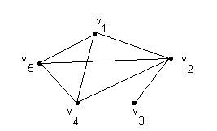
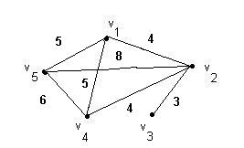
Special graphs
Simple graph
A graph without loops or parallel edges.
Weighted graph
A graph where each edge is assigned a numerical label or “weight”.

Slide 38
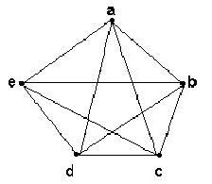
Complete graph K _{n}
Let n > 3
The complete graph K_{n} is the graph with n vertices and every pair of vertices is joined by an edge.
The figure represents K₅

Slide 39
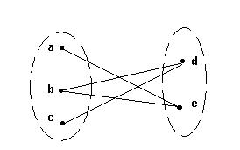
Bipartite graphs
A bipartite graph G is a graph such that
V(G) = V(G₁) ∪ V(G₂)
|V(G₁)| = m, |V(G₂)| = n
V(G₁) ∩V(G₂) = ∅
No edges exist between any two vertices in the same subset V(G_{k}), k = 1,2

Slide 41
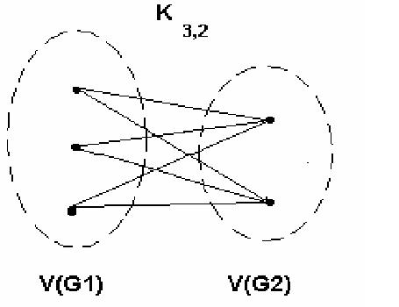
Complete bipartite graph K_{m,n}
A bipartite graph is the complete bipartite graph K_{m,n} if every vertex in V(G₁) is joined to a vertex in V(G₂) and conversely,
|V(G₁)| = m
|V(G₂)| = n

Slide 42
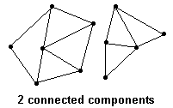
Connected graphs
A graph is connected if every pair of vertices can be connected by a path
Each connected subgraph of a non-connected graph G is called a component of G

Slide 43
Regular Graphs
A graph is called a Regular Graph if degrees of all
Vertices are same.
For example,
Triangle is a Regular Graph of Size 2 (called 2-Regular Graph).
Line segment is 1-Regular Graph
Square is a 2-Regular Graph
Square with both diagonals is 3-Regular Graph

Slide 44
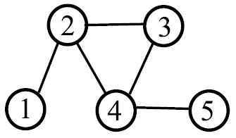
Subgraph
Subgraph G’ =(V’,E’) of G=(V,E)
If V’ ⊂ V,
E’ ⊂ E
(v1,v2) ∈ E’ iff (v1,v2) ∈ E
and (v1,v2) ∈E’
A Complete Subgraph is called a Clique
c
a
b
d
e

Slide 45
N-cube: The n-cube, denoted by Q_{n}, is the graph that has vertices representing the 2^{n} bit strings of length n. Two vertices are adjacent if and only if the bit strings that they represent differ in exactly one bit position.
011
111
01
11
010
110
001
101
0
1
00
10
000
100
Q₁
Q₂
Q₃

Slide 46
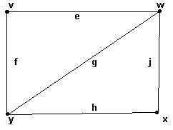
Representations of graphs
Adjacency matrix
Rows and columns are labeled with ordered vertices
write a 1 if there is an edge between the row vertex and the column vertex
and 0 if no edge exists between them
 | v | w | x | y
v | 0 | 1 | 0 | 1
w | 1 | 0 | 1 | 1
x | 0 | 1 | 0 | 1
y | 1 | 1 | 1 | 0

Slide 47
Incidence matrix
Incidence matrix
Label rows with vertices
Label columns with edges
1 if an edge is incident to a vertex, 0 otherwise
 | e | f | g | h | j
v | 1 | 1 | 0 | 0 | 0
w | 1 | 0 | 1 | 0 | 1
x | 0 | 0 | 0 | 1 | 1
y | 0 | 1 | 1 | 1 | 0

Slide 48
Paths
Path: sequence of adjacent vertices
(
)

Slide 49
Simple Paths
Simple Path: all vertices different
(
)

Slide 50
Connectedness
Vertices v, w are connected if and only if
there is a path starting at v and ending at w.
A graph is connected iff every pair of vertices are connected.
Every graph consists of separate connected pieces called connected components
13
12
26
16
66
E17
E25
10
8
4
3 connected components
So a graph is connected if and only if it has only 1 connected component.

Slide 51
Cycles
A cycle is a path that begins and ends with same vertex.
v
a
w
b
cycle: v ···b ···w ···w ···a ···v
also: a ···v ···b ···w ···w ···a

Slide 52
Simple Cycles
A simple cycle is a cycle that doesn’t cross itself
In a simple cycle, every vertex is of degree exactly 2.
v
w
cycle: v ···w ···v
also: w ···v ···w

Slide 53
Shortest Paths
A path between u and v is a shortest path
if among all u-v paths it uses the minimum number of edges.
Is a shortest path between two vertices always simple?
Idea: remove the cycle will make the path shorter.
c
u
v

Slide 54
Shortest Paths
Lemma. A shortest path between two vertices is simple.
Proof (by contradiction):
Suppose there is a non-simple shortest path P=(u,…,v)
Let c be the first vertex that is visited twice.
Then P=(u,P1,c,P2,c,P3,v).
But P’=(u,P1,c,P3,v) is shorter, a contradiction.
c
P3
u
v
P1
P2
This is a simple cycle
without using vertices in P1

Slide 55
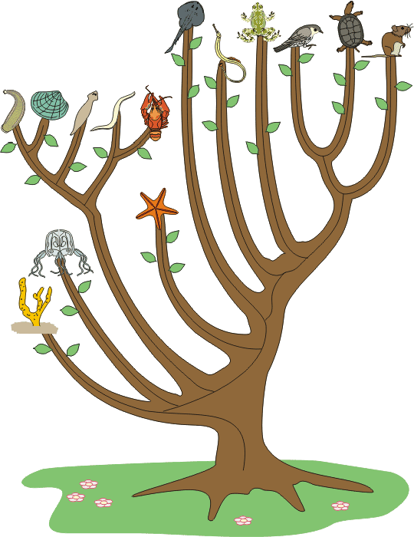
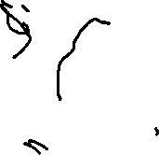
Tree
Graphs with no cycles?
A forest.
Connected graphs with no cycles?
A tree.

Slide 56
More Trees
leaf
leaf
A leaf is a vertex of degree 1.
More leaves.
Even more leaves.

Slide 57
Tree Characterization by Path
Definition. A tree is a connected graph with no cycles.
Can there be no path between u and v?
NO
Can there be more than one simple path between u and v?
NO
u
v
This will create cycles.
Claim. In a tree, there is a unique simple path between every pair of vertices.

Slide 58
Tree Characterization by Number of Edges
Definition. A tree is a connected graph with no cycles.
Can a tree have no leaves?
NO
Then every vertex has degree at least 2.
Go to unvisited edges as long as possible.
Cannot get stuck,
unless there is a cycle.

Slide 59
Tree Characterization by Number of Edges
Definition. A tree is a connected graph with no cycles.
Can a tree has no leaves?
NO
How many edges does a tree with N nodes have?
N-1?
We usually use n to denote the number of vertices,
and use m to denote the number of edges in a graph.

Slide 60
Tree Characterization by Number of Edges
Definition. A tree is a connected graph with no cycles.
Look at a leaf v.
Is T-v a tree?
YES
v
Can T-v has a cycle?
Is T-v connected?
NO
YES
By induction, T-v has (n-1)-1=n-2 edges.
So T has n-1 edges.

Slide 61
Tree Characterizations
Definition. A tree is a connected graph
with no cycles.
Characterization by paths:
A graph is a tree if and only if there is a unique
simple path between every pair of vertices.
Characterization by number of edges:
A graph is a tree if and only if it is connected and has n-1 edges.

Slide 62
Connected graphs
A graph is connected if every pair of vertices can be connected by a path
Each connected subgraph of a non-connected graph G is called a component of G

Slide 63
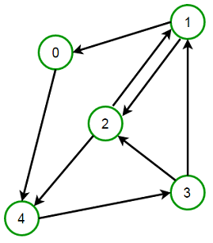
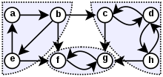
Strongly Connected Graphs and Strongly Connected Components
A directed graph is called strongly connected if there is a path in each direction between each pair of vertices of the graph.
In a directed graph G that may not itself be strongly connected, a pair of vertices u and v are said to be strongly connected to each other if there is a path in each direction between them.
A Strongly Connected Subgraph is Called Strongly Connected Component

Slide 64
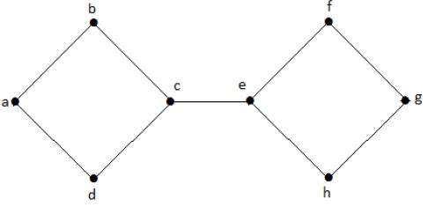
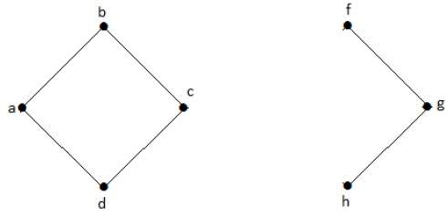
Cut Vertex and Cut Edge
A Cut Vertex is a Vertex whose removal makes a connected graph a disconnected graph.
A Cut Edge is an Edge whose removal makes a connected graph a disconnected graph.
V1’={c} V2’={e}, E’={ce}

Slide 65
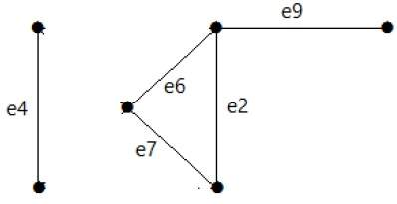
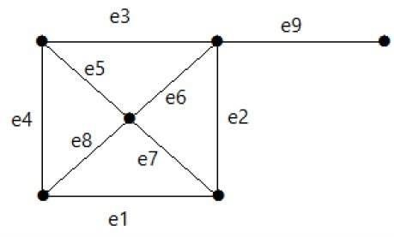
Cut set
In a connected graph G, if a set of edges are removed in order to make it disconnected then this set is called Cut Set
E’={e3,e5,e8,e1}

Slide 66
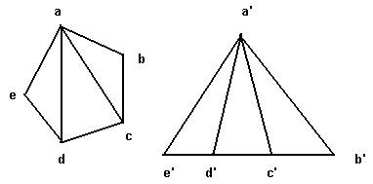
Isomorphic graphs
G₁ and G₂ are isomorphic
if there exist one-to-one onto functions f: V(G₁) → V(G₂) and g: E(G₁) → E(G₂) such that
an edge e is adjacent to vertices v, w in G₁ if and only if g(e) is adjacent to f(v) and f(w) in G₂

Slide 67
Graph Isomorphism
All that matters is the connections.
Graphs with the same connections are isomorphic.
Informally, two graphs are isomorphic if they are
the same after renaming.
G₁ isomorphic to G₂ means there is an edge-preserving vertex matching.
relation preserving
renaming function
Graph isomorphism has applications like checking
fingerprint, testing molecules…

Slide 68
Are These Isomorphic?
A bijection.
Hay
Dog
Pig
Corn
Cow
Cat
Beef
Tuna
f (Dog) = Beef
f (Cat) = Tuna
f (Cow) = Hay
f (Pig) = Corn

Slide 69
Are These Isomorphic?
A bijection.
Hay
Dog
Pig
Corn
Cow
Cat
Beef
Tuna
Edge preserved?
YES!
If there is an edge in the original graph,
there is an edge after the mapping.

Slide 70
Are These Isomorphic?
A bijection.
Hay
Dog
Pig
Corn
Cow
Cat
Beef
Tuna
Non-Edge preserved?
YES!
If there is no edge in the original graph,
there is no edge after the mapping.

Slide 71
Graph Isomorphism
G₁ isomorphic to G₂ means there is an edge-preserving vertex matching.
 bijection f: V₁ → V₂
u —v in E₁ iff f (u)—f (v) in E₂
uv is an edge in G1
f(u)f(v) is an edge in G2
If G1 and G2 are Isomorphic they will have same number of Edges, Vertices, and Degree incidence.
However, two Graphs with same degree incidences need not be isomorphic

Slide 72
Exercise
How to show two graphs are isomorphic?
Find a mapping and show that it is edge preserving.
How to show two graphs are non-isomorphic?
Find some isomorphic-preserving properties
which is satisfied in one graph but not the other.
Non-isomorphic
degree 2
all degree 3

Slide 73
Testing graph isomorphism is not easy
Exercise
Which is isomorphic to G1?

Slide 74
Testing graph isomorphism is not easy –
No known general method to test graph-ismorphism which is much more efficient than checking all possibilities.
It is, in general, not solvable in Polynomial Time.
However, for some special graphs like Trees and Planar Graphs, it has been proved to be solvable in Polynomial time.

Slide 75
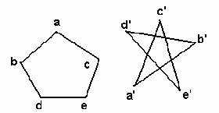
Isomorphism and adjacency matrices
Two graphs are isomorphic if and only if
after reordering the vertices their adjacency matrices are the same
 | a | b | c | d | e
a | 0 | 1 | 1 | 0 | 0
b | 1 | 0 | 0 | 1 | 0
c | 1 | 0 | 0 | 0 | 1
d | 0 | 1 | 0 | 0 | 1
e | 0 | 0 | 1 | 1 | 0

Slide 76
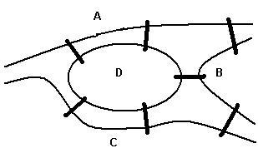
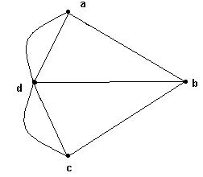
Euler cycles
An Euler cycle in a graph G is a simple cycle that passes through every edge of G only once.
The Königsberg bridge problem:
Starting and ending at the same point, is it possible to cross all seven bridges just once and return to the starting point?
This problem can be represented by a graph
Edges represent bridges and each vertex represents a region.

Slide 77
Euler graphs
A graph G is an Euler graph if it has an Euler cycle.
Theorems : G is an Euler graph if and only if G is connected and all its vertices have even degree.
The connected graph represents the Konigsberg bridge problem.
It is not an Euler graph.
Therefore, the Konigsberg bridge problem has no solution.

Slide 78
Euler Paths and Circuits
An Euler path is a path using every edge of the graph G exactly once.
An Euler circuit is an Euler path that returns to its start.
C
Does this graph have an Euler circuit? No
Does this graph have an Euler Path? No
A
D
.
B

Slide 79
Necessary and Sufficient Conditions
How about multigraphs?
A connected multigraph has a Euler circuit iff each of its vertices has an even degree.
A connected multigraph has a Euler path but not an Euler circuit iff it has exactly two vertices of odd degree.
Remove ‘ad’ (or ab or bc or dc)
Does it have an Euler’s path now?

Slide 80
Example
Which of the following graphs has an Euler circuit/ Path?
a
b
a
b
a
b
e
e
d
c
d
c
c
d
e
Circuit: yes no no
(a, e, c, d, e, b, a)
Path: yes yes
(a, e, c, d, e, b, a ) no (a, c, d, e, b, d, a, b)

Slide 81
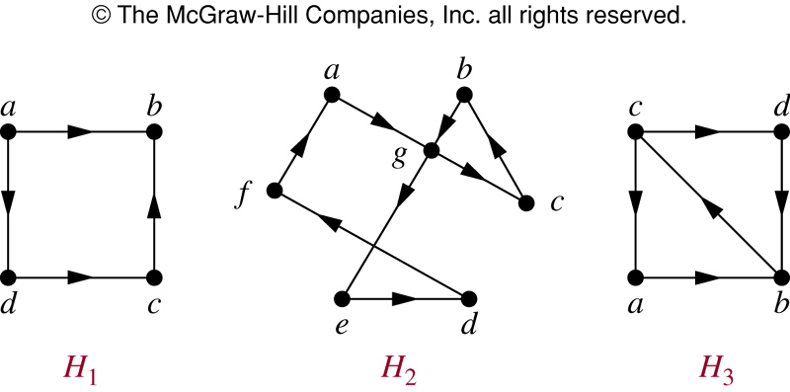
Euler Circuit and Paths in Directed Graphs
Circuit NO (a, g, c, b, g, e, d, f, a) NO
Path: NO (a, g, c, b, g, e, d, f, a) (c, a, b, c, d,b)

Slide 82
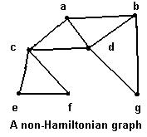
Hamiltonian cycles
Traveling salesperson problem
To visit every vertex of a graph G only once by a simple cycle.
Such a cycle is called a Hamiltonian cycle.
If a connected graph G has a Hamiltonian cycle, G is called a Hamiltonian graph.

Slide 83
Hamilton Paths and Circuits
A Hamilton path in a graph G is a path which visits every vertex in G exactly once.
A Hamilton circuit is a Hamilton path that returns to its start.

Slide 84
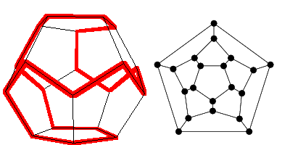
Hamilton Circuits
Dodecahedron puzzle and it equivalent graph
Is there a circuit in this graph that passes through each vertex exactly once?

Slide 85
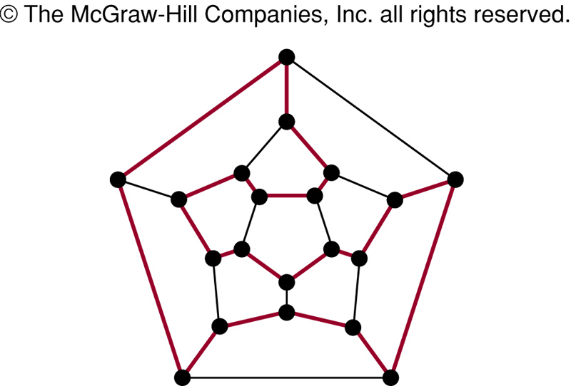
Hamilton Circuits
Yes; this is a circuit that passes through each vertex exactly once.

Slide 86
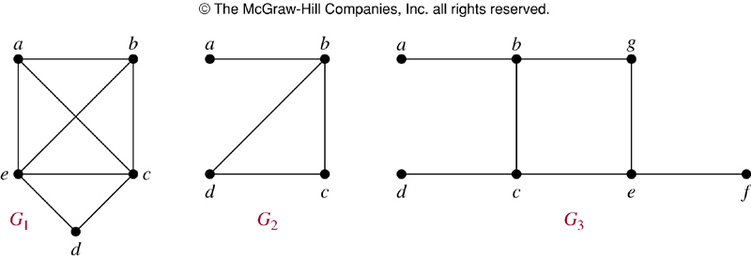
Finding Hamilton Circuits
Which of these three figures has a Hamilton circuit? Of, if no Hamilton circuit, a Hamilton path?

Slide 87
Finding Hamilton Circuits
G₁ has a Hamilton circuit: a, b, c, d, e, a
G₂ does not have a Hamilton circuit, but does have a Hamilton path: a, b, c, d
G₃ has neither.

Slide 88
Finding Hamilton Circuits
Unlike the Euler circuit problem, finding Hamilton circuits is hard.
There is no simple set of necessary and sufficient conditions, and no simple algorithm.

Slide 89
Properties to look for ...
No vertex of degree 1
If a node has degree 2, then both edges incident to it must be in any Hamilton circuit.
No smaller circuits contained in any Hamilton circuit (the start/endpoint of any smaller circuit would have to be visited twice).

Slide 90
A Sufficient Condition
Let G be a connected simple graph with n vertices with n ≥ 3.
If the degree of each vertex is ≥ n/2,
then G has a Hamilton circuit.

Slide 91
Travelling Salesman Problem
A Hamilton circuit or path may be used to solve practical problems that require visiting “vertices”, such as:
road intersections
pipeline crossings
communication network nodes
A classic example is the Travelling Salesman Problem – finding a Hamilton circuit in a complete graph such that the total weight of its edges is minimal.

Slide 92
Summary
Property | Euler | Hamilton
Repeated visits to a given node allowed? | Yes | No
Repeated traversals of a given edge allowed? | No | No
Omitted nodes allowed? | No | No
Omitted edges allowed? | No | Yes

Slide 93
Complement of a Graph A graph G’= (V,E’) is called complement of a graph G, if E’= all edges of complete graph which are not in G.

Slide 94
Critical Path Method (CPM)
CPM is a project network analysis technique used to predict total project duration
A critical path for a project is the series of activities that determines the earliest time by which the project can be completed
The critical path is the longest path through the network diagram and has the least amount of slack or float

Slide 95
Finding the Critical Path
First develop a good project network diagram
Add the durations for all activities on each path through the project network diagram
The longest path is the critical path

Slide 96
Simple Example of Determining the Critical Path
Consider the following project network diagram. Assume all times are in days.
How many paths are on this network diagram?
How long is each path?
c. Which is the critical path?
d. What is the shortest amount of time needed to complete this project?

Slide 97
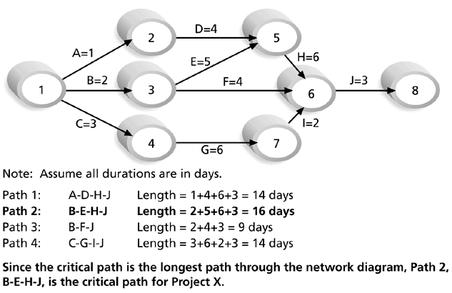
Determining the Critical Path for Project X

Slide 98
More on the Critical Path
If one of more activities on the critical path takes longer than planned, the whole project schedule will slip unless corrective action is taken
Misconceptions:
The critical path is not the one with all the critical activities; it only accounts for time
There can be more than one critical path if the lengths of two or more paths are the same
The critical path can change as the project progresses

Slide 99
Using Critical Path Analysis to Make Schedule Trade-offs
Knowing the critical path helps you make schedule trade-offs
Free slack or free float is the amount of time an activity can be delayed without delaying the early start of any immediately following activities

Slide 100
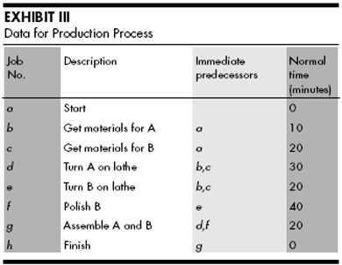
Critical Path :

Slide 101
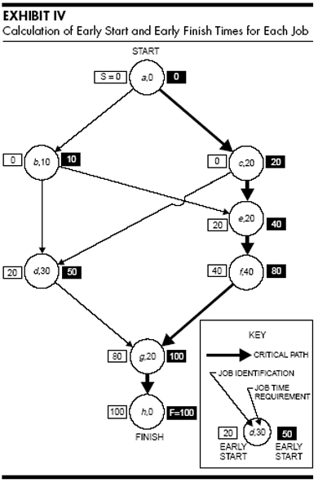

Slide 102
Graph Colouring
Graph Colouring Problem:
Given a graph, colour all the vertices so that
two adjacent vertices get different colours.
Objective: use minimum number of colours.
3-colourable

Slide 103
Optimal Colouring
Definition. min #colors for G is chromatic number, (G)
What graphs have chromatic number one?
when there are no edges…
What graphs have chromatic number 2?
What graphs have chromatic number larger than 2?
A path? A cycle? A triangle?

Slide 104
Simple Cycles

Slide 105
Complete Graphs

Slide 106
Wheels

Slide 107
Trees
root
Pick any vertex as “root.”
if (unique) path from root is
even length:
odd length:
Can prove more formally using induction.

Slide 108
2-Colourable Graphs
When exactly is a graph 2-colourable?
This is 2-colourable.
2 colourable: tree, even cycle, etc.
Not 2 colourable: triangle, odd cycle, etc.

Slide 109
Bipartite Graphs
When exactly is a graph 2-colourable?
Is a bipartite graph 2-colourable?
Is a 2-colourable graph bipartite?
Fact. A graph is 2-colourable if and only if it is bipartite.

Slide 110
Bipartite Graphs
When exactly is a graph bipartite?
Can a bipartite graph has an odd cycle?
NO
If a graph does not have an odd cycle, then it is bipartite?

Slide 111
Bipartite Graphs
When exactly is a graph bipartite?
No such edge because no 5-cycle
The idea is like colouring a tree.
Pick a vertex v, colour it red.
Colour all its neighbour green.
Colour all neighbours of green vertices red
Repeat until all vertices are coloured.
No such edge because no triangle
If a graph does not have an odd cycle, then it is bipartite?
Theorem. A graph is bipartite if and only if it has no odd cycle.

Slide 112
Chromatic Number
How do we estimate the chromatic number of a graph?
If there is a complete subgraph of size k,
then we need at least k colours?
YES
Is the converse true?
If a graph has no complete subgraph of size 4,
then we can colour it using 4 colours?
NO
What graphs are 3-colourable?
No one knows a good characterization…

Slide 113
Flight Gates
flights need gates, but times overlap.
how many gates needed?
time
122
145
67
257
306
99
Flights

Slide 114
Conflict Graph
Needs gate at same time
145
Each vertex represents a flight
Each edge represents a conflict
306
99

Slide 115
Graph Colouring
257
122
145
67
306
9
There is a k-colouring in this graph iff the flights can be scheduled using k gates.
=> If there is a schedule, the flights scheduled at the same gate have no conflict,
and so we can colour the graph by using one colour for flights in each gate.
<= If there is a graph colouring, then the vertices using each colour have no conflict,
and so we can schedule the flights having the same colour in one gate.

Slide 116
Colouring the Vertices
257
122
145
assign
gates:
67
306
257, 67
122,145
99
306
4 colors
4 gates
99

Slide 117
Better Colouring
257
122
145
67
306
3 colors
3 gates
99

Slide 118

Final Exams
subjects conflict if student takes both,
so need different time slots.
how short an exam period?
This is a graph colouring problem.
Each vertex is a course, two courses have an edge if there is a conflict.
The graph has a k-colouring if and only if
the exams can be scheduled in k days.

Slide 119
Graph Colouring
8.02
6.042
18.02
assign
times:
3.091
M 9am
M 1pm
T 9am
T 1pm
4 time slots
(best possible)
6.001

Slide 120
Register Allocation
Given a program, we want to execute it as quick as possible.
Calculations can be done most quickly if the values are stored in registers.
But registers are very expensive, and there are only a few in a computer.
Therefore we need to use the registers efficiently.
This is a graph colouring problem.

Slide 121
Register Allocation
Each vertex is a variable.
Two variables have a conflict if they cannot be put into the same register.
a and b cannot use the same register, because they store different values.
c and d cannot use the same register otherwise the value of c is overwritten.
Each colour corresponds to a register.

Slide 122
Good News
For some special graphs, we know exactly when they are k-colourable.
Interval graphs (conflict graphs of intervals):
b
b
d
d
a
a
c
c
For interval graphs,
minimum number of colours need = maximum size of a complete subgraph
So the “flight gate” problem and the “register allocation” can be solved.

Slide 123
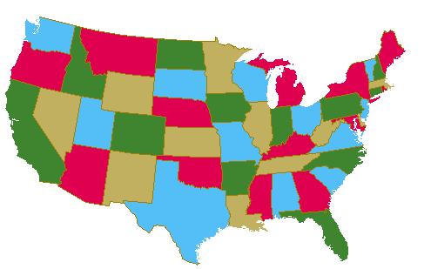
Map Colouring
Colour the map using minimum number of colours so that
two countries sharing a border are assigned different colours.

Slide 124
Map Colouring
Can we draw a map so that there are 5 countries
such that they are pairwise adjacent?
NO
Can we draw a map which need 5 colours?
NO
Conjecture (1852) Every map is 4-colourable.
“Proof” by Kempe 1879, an error is found 11 years later.
(Kempe 1879) Every map is 5-colourable.
Theorem (Apple Haken 1977). Every map is 4-colourable.
The proof is computer assisted, some mathematics are still not happy.

Slide 125
Planar Graphs
- Each vertex is a region.
- Two regions have an edge
if they are adjacent.
This is a planar graph.
A graph is planar if there is a way to
draw it in the plane without edges crossing.

Slide 126
Non-Planar Graphs
Can we draw a map so that there are 5 countries
such that they are pairwise adjacent? (each country is adjacent to
4 countries)
NO

Slide 127
Four Continuous Faces
An important concept of a planar graph is its faces.
So let’s study it in some details.
II
IV
II
I
4 Connected Regions

Slide 128
Region Boundaries
b
a
c
d

Slide 129
Region Boundaries
abca
b
a
c
d

Slide 130
Region Boundaries
abca
b
abda
a
c
d

Slide 131
Region Boundaries
abca
b
abda
a
c
acda
d
outer region

Slide 132
Region Boundaries
abca
b
abda
a
bcdb
c
acda
outer region
d

Slide 133
Region Boundaries: Bridge

Slide 134
Region Boundaries: Bridge
f
b
a
c
e
efge
abcda
g
d
abcefgecda
outer region

Slide 135
Euler’s Formula
If a connected planar graph has v vertices, e edges, and f faces, then
v –e +f = 2
v=5, e=5, f=2
v=6, e=10, f=6
v=9, e=8, f=1

Slide 136
Proof of Euler’s Formula
If a connected planar graph has v vertices, e edges, and f faces, then
v –e +f = 2
Proof by induction on the number of vertices.
Base case (v=1):
v=1
f=e+1

Slide 137
Proof of Euler’s Formula
If a connected planar graph has v vertices, e edges, and f faces, then
v –e +f = 2
Induction step (v>1):
“contract” the red edge
v’=v-1, e’=e-1, f’=f
Number of faces is the same, although some faces get shorter.
By induction, v’-e’+f’=2. This implies v-e+f=2.

Slide 138

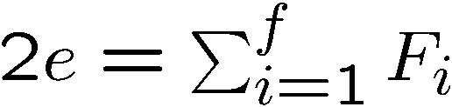
Application of Euler’s Formula
Claim. If G is a simple planar graph with at least 3 vertices, then
e <= 3v-6
Let be the face lengths.
Note that
Contributes one to two faces
because each edge contributes 2 to the sum
Contributes two to one face

Slide 139
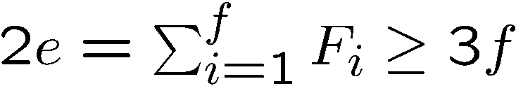
Application of Euler’s Formula
Claim. If G is a simple planar graph with at least 3 vertices, then
e <= 3v-6
Let be the face lengths.
Note that
Since the graph is simple, each face is of length at least 3.
So
Since e = v+f-2, this implies

Slide 140
Application of Euler’s Formula
Claim. If G is a simple planar graph with at least 3 vertices, then
e <= 3v-6
Claim. Every simple planar graph has a vertex of degree at most 5.
Suppose every vertex has degree at least 6.
Then e >= 6v/2 = 3v.
A contradiction.

Slide 141
6-Colouring Planar Graphs
Claim. Every simple planar graph has a vertex of degree at most 5.
Theorem. Every planar graph is 6-colourable.
v
Proof by induction on the number of vertices.
Let v be a vertex of degree at most 5.
Remove v from the planar graph G.
Note that G-v is still a planar graph.
By induction, G-v is 6-colourable.
Since v has at most 5 neighbours,
v can always choose a colour (from the 6 colours).
G-v

Slide 142
Application of Euler’s Formula
Can we draw a map so that there are 5 countries
such that any two of which are adjacent?
NO
Can this graph have a planar drawing?
Claim. If G is a simple planar graph with at least 3 vertices, then
e <= 3v-6
This graph has v=5 and e=10, and so does not satisfy the claim.

Slide 143
Time Complexity
The best algorithms known for finding the chromatic number of a graph have exponential
worst-case time complexity (in the number of vertices of the graph).
Even the problem of finding an approximation to the chromatic number of a graph is difficult.
This explains why scheduling final exams is so difficult, i.e., how can the final exams at a university be scheduled so that no student has two exams at the same time?

